Slide 1

Risk and farmer uptake of
sustainable agricultural intensification innovations
Chris Barrett
Cornell University
Royal Society workshop on Food and Nature:
Science and Practice for Sustainable, Land Efficient Farming
London, UK
April 21, 2026

Slide 2
Innovation risk
Adoption itself is risky:
Need to learn how to use new tool/method (esp. for knowledge intensive practices – SRI, ISFM, IPM, cover crops, agroforestry, etc.)
Social/own identity acceptability
Extension services, agro-input dealers, farmer field schools, chosen diffusion nodes (‘master farmers’, authority figures, etc.)

Slide 3
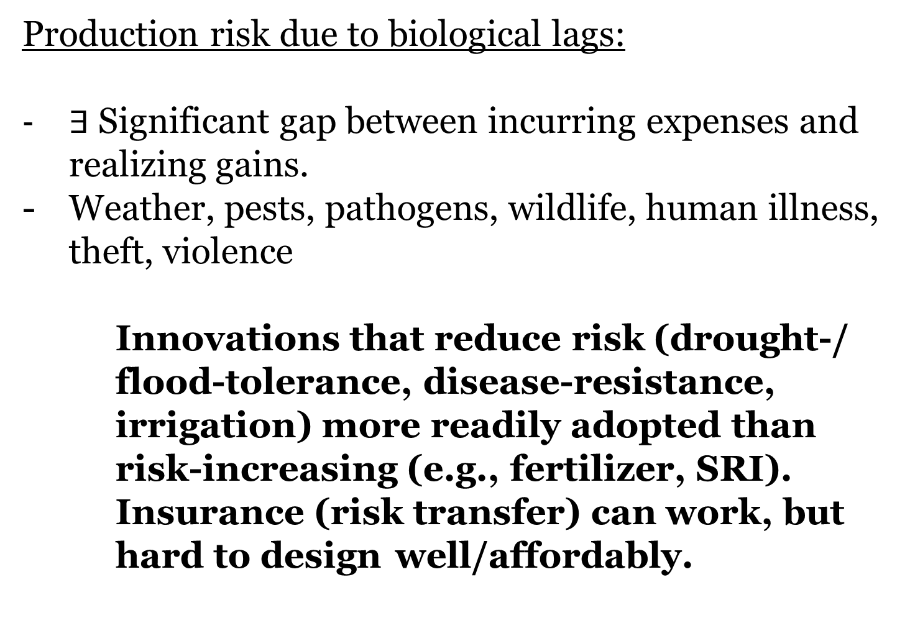
Production risk
Production risk due to biological lags:
$∃$Significant gap between incurring expenses and realizing gains.
Weather, pests, pathogens, wildlife, human illness, theft, violence
Innovations that reduce risk (drought-/ flood-tolerance, disease-resistance, irrigation) more readily adopted than risk-increasing (e.g., fertilizer, SRI). Insurance (risk transfer) can work, but hard to design well/affordably.

Slide 4
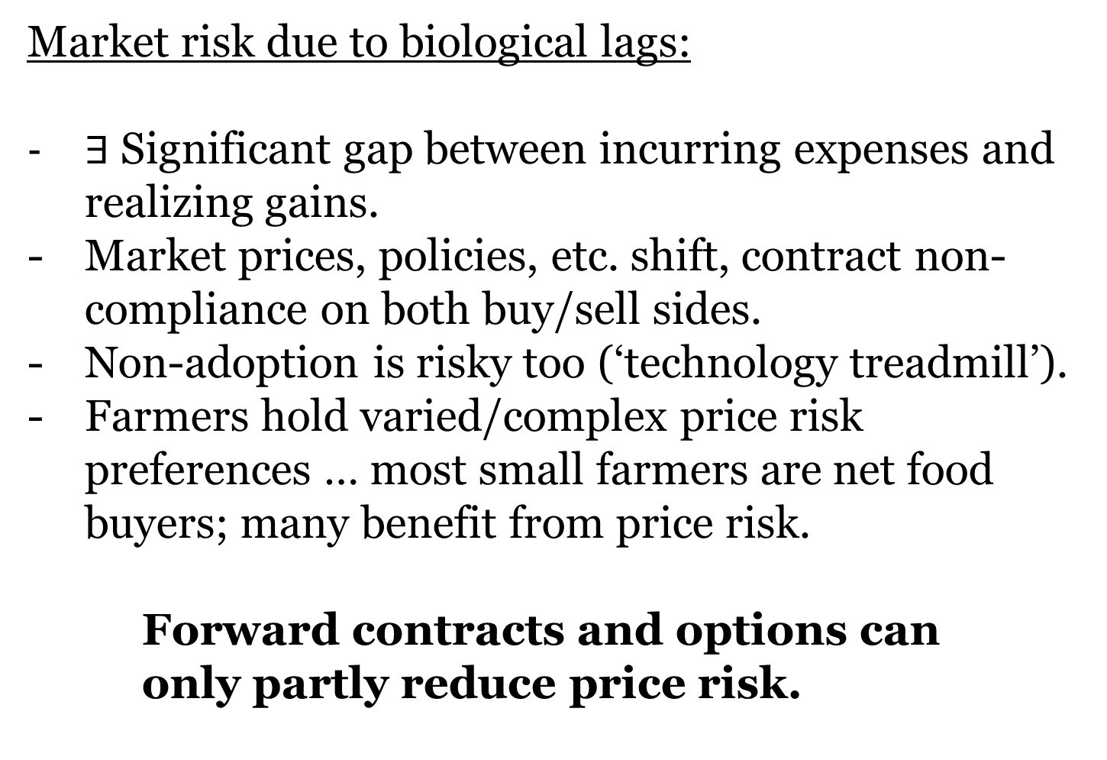
Market risk
Market risk due to biological lags:
$∃$Significant gap between incurring expenses and realizing gains.
Market prices, policies, etc. shift, contract non-compliance on both buy/sell sides.
Non-adoption is risky too (‘technology treadmill’).
Farmers hold varied/complex price risk preferences … most small farmers are net food buyers; many benefit from price risk.
Forward contracts and options can only partly reduce price risk.

Slide 5
Risk is ubiquitous
Adoption/uptake is fraught with many sources of risk.
Thus need E[gains] > risk premia to induce/accelerate uptake of SAI innovations
Ability/willingness to absorb risk varies a LOT.
Increase gains and/or decrease risk exposure through bundled interventions that accompany core agricultural innovation.
Hard to get the designs right to induce uptake at scale but not overcompensate (esp. well-off).

Slide 6
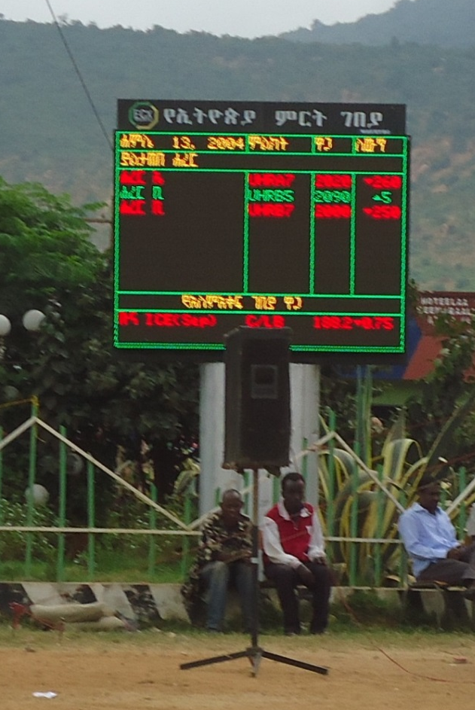
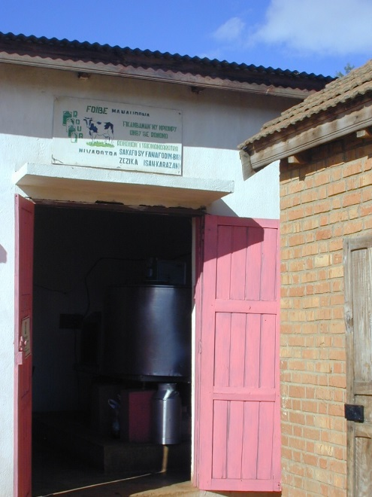
Thanks for your interest

